Slide 1
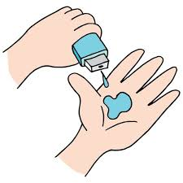
Healthcare Analytics for Doctor Visits
Student Name : Atshaya.S
AICTE ID : :APPLY_172728567366f449a94c7a7 Internship ID
COLLEGE : IFET college of Engineering

Slide 2

PROBLEM STATEMENT
Overview: Efficient healthcare delivery is critical, but doctor visits often face issues like long waiting times, scheduling conflicts, and patient dissatisfaction.
Challenges:
High patient wait times due to unoptimized scheduling.
Lack of data insights into peak times, causing resource mismanagement.
Objective: Apply healthcare analytics to streamline doctor visits, enhance patient satisfaction, and improve resource allocation.

Slide 3
Project Description [write detail description about your project ]
Objective:
To analyze data from patient appointments, demographics, and feedback to identify actionable insights.
Use analytics to forecast peak hours, streamline scheduling, and manage patient flow effectively.
Methodology:
Collect and analyze patient visit data, such as visit frequency, duration, and patient demographics.
Use predictive analytics to improve scheduling and reduce wait times.
Goals:
Improve patient experience by reducing waiting times.
Help hospitals and clinics allocate resources effectively.
Increase doctor and staff efficiency by optimizing scheduling.

Slide 4

WHO ARE THE END USERS?
Healthcare Providers: Doctors, nurses, and other medical staff benefit from a smoother workflow and reduced scheduling conflicts.
Hospital Administrators: Gain insights to better allocate resources and improve patient satisfaction.
Patients: Experience shorter wait times, enhanced service, and improved overall satisfaction.

Slide 5

Technology Used
Data Analytics Tools:
Programming Languages: Python, R for data analysis and modeling.
Visualization Tools: Tableau, Power BI for data visualization and reporting.
Database Systems: SQL for managing and querying appointment data.
Machine Learning Models:
Predictive Models: To forecast peak patient flow times.
Clustering: To identify patient segments and their unique needs.

Slide 6
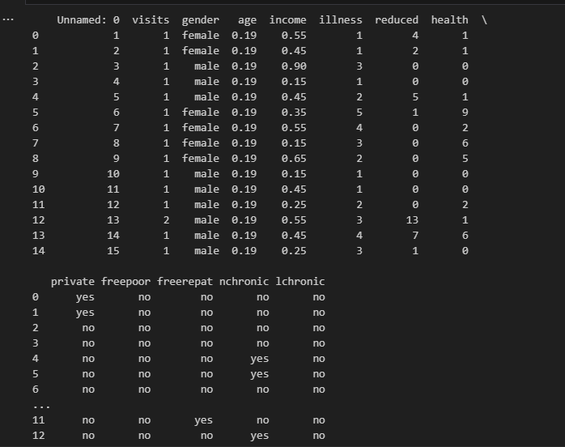
RESULTS
Demo Link

Slide 7
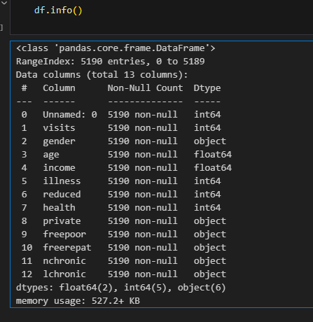
RESULTS
Demo Link

Slide 8
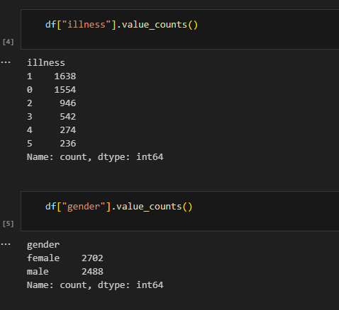
RESULTS
Text
Demo Link

Slide 9
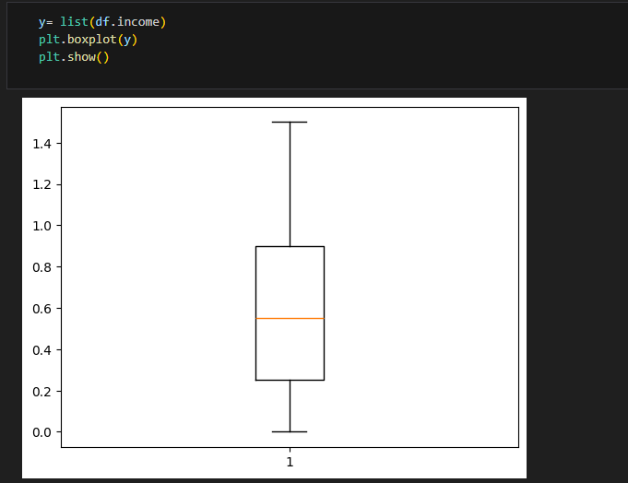
RESULTS
Demo Link

Slide 10
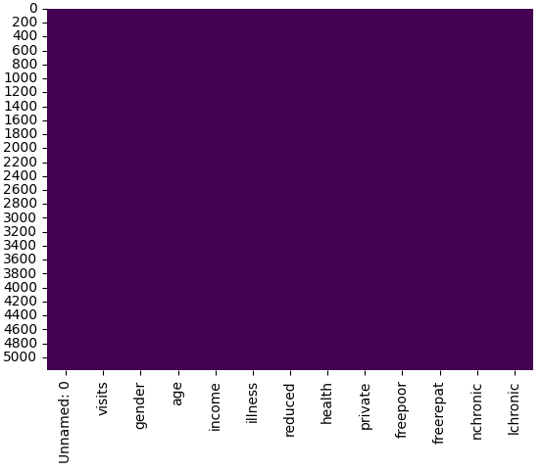
RESULTS
Text
Demo Link

Slide 11
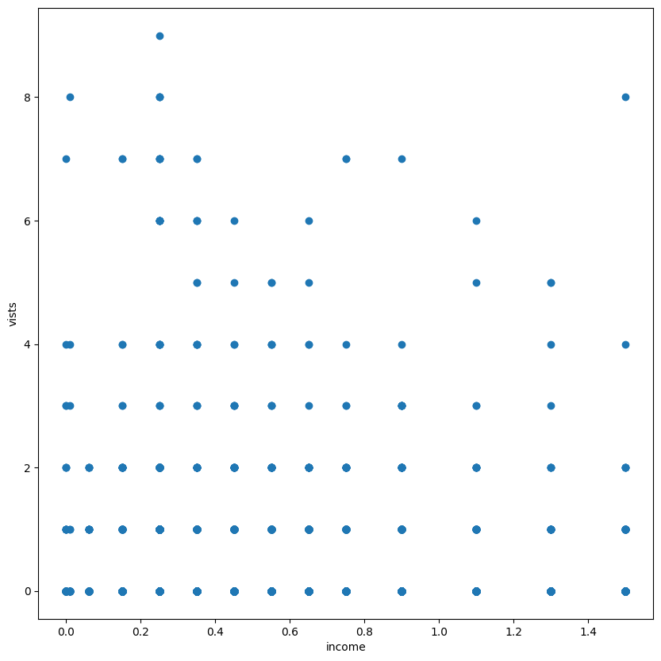
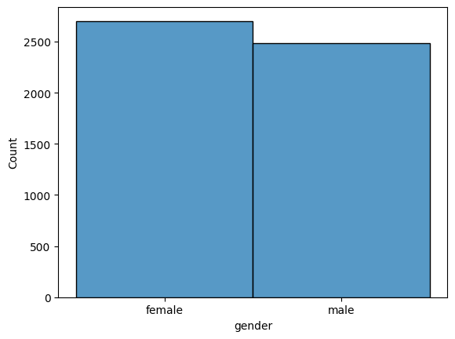
RESULTS
Demo Link

Slide 12
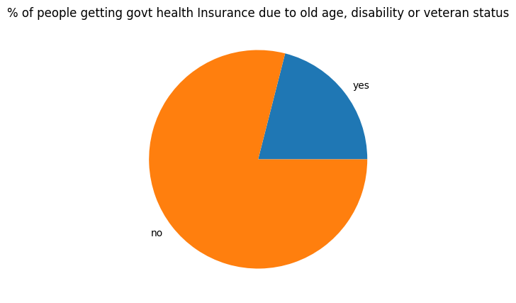
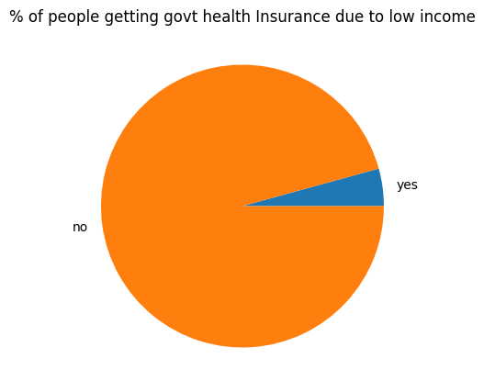
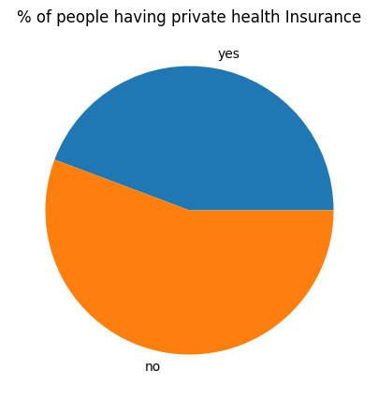
RESULTS
Demo Link

Slide 13
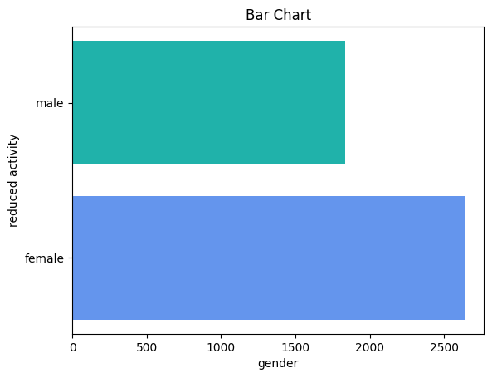
RESULTS
Demo Link

Slide 14

Thank you
.
.

